Slide 1
Hybrid Solar Irradiance Now-Casting by fusing Kalman Filter and Regressor
To Dr. Sumanta Pasari, Department of Mathematics, BITS Pilani, Pilani Campus
By Uday Mittal
2019B4A70662P

Slide 2
Abstract
A Hybrid Solar Irradiance Now-casting mechanism is proposed.
The proposed hybrid predictor fuses the results from both Kalman Filter Predictor and Regressor Predictor, so that the benefits from both the techniques can be achieved.
A time-varying adaptive system function for Kalman Filter is designed to deal with ramp-down events for more accurate predictions.
Three fusion alternative mechanisms have been proposed and compared. They are based on local root mean square error computation.

Slide 3
Highlights
The System aims to obtain the predicted Irradiance using the information of the previous and current ground truth irradiance and all sky images.
Both Kalman Filter and Regressor Predictor generates a prediction which is based on current and previous ground truth irradiance and ramp down event forecasting results.
The forecast is achieved through two-class Support Vector Machines (SVM).
All sky image features and history ground truth irradiance is used to form feature vectors for classification purposes.
The feature vectors and corresponding ramp-down events train the classifier, which behaves as per the forecasted event at a future time.

Slide 4
Introduction
Governments and International Organizations have consistently promoted sustainable and renewable energy to alleviate the energy crisis dominated by fossil fuels and act against adverse effects indicted by the growing emission of carbon dioxide in the atmosphere.
Compared to finite quantities of fossil fuels, solar light, winds, and waves are energy resulting from the activities of the Earth, Sun, and Moon and enjoy the advantage of being sustainable.
In addition, the production and use of renewable energy involve negligible emissions compared to fossil fuels.
Solar energy is one sustainable energy that has received growing attention in recent years.
Photo-Voltaics (PV) are in great demand now-a-days, due to their clean and renewable electricity generation in residential, commercial, and industrial areas.
Medium term and Short term prediction schemes are required by the PV grid operators for efficient and accurate solar irradiance prediction.
The prediction horizon for short term to medium term prediction ranges from few hours to a few days.
The prediction horizon for very short term irradiance prediction ranges from three to fifteen minutes.
If the accurate amount of solar energy drop can be forecasted then it will help in reducing the overhead of backup storage.

Slide 5
Methodology
Kalman Filter, also known as Linear Quadratic Estimation (LQE), is an algorithm that uses a series of measurements observed over time, including statistical noise and other inaccuracies.
It produces estimates of unknown variables that tend to be more accurate than those based on a single measurement alone by estimating a joint probability distribution over the variables for each timeframe.
The data used by the author is taken from National Central University of Taiwan.
The dataset contains all sky images and irradiance readings from January 2014 to September 2014.
The datasets records one all-sky image and one irradiance reading per minute.
The data goes through Image feature extraction and Ramp-down event forecast, which finally feeds data into the Kalman Filter and Regressor Predictor.
The data obtained from Kalman Filter and Regressor Predictor are clubbed with the Local Root Mean Square Error Computation, which gives the Hybrid Predicted Result.

Slide 6
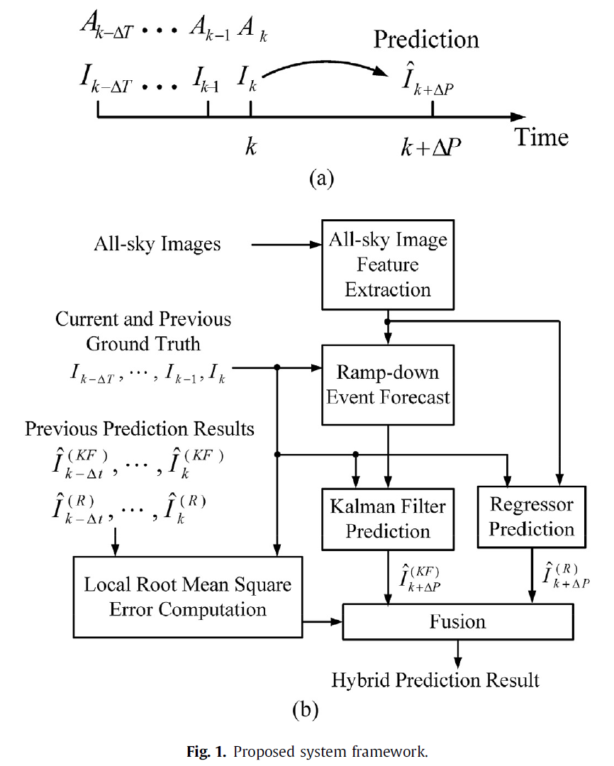

Slide 7
Current Task
To download the datasets from the NSRDB website
Compare it with the data sets of the author.
Understand the similarities and differences between the two datasets.
Develop a model implementing the work of the author as per our dataset, especially for Indian Subcontinent.

Slide 8
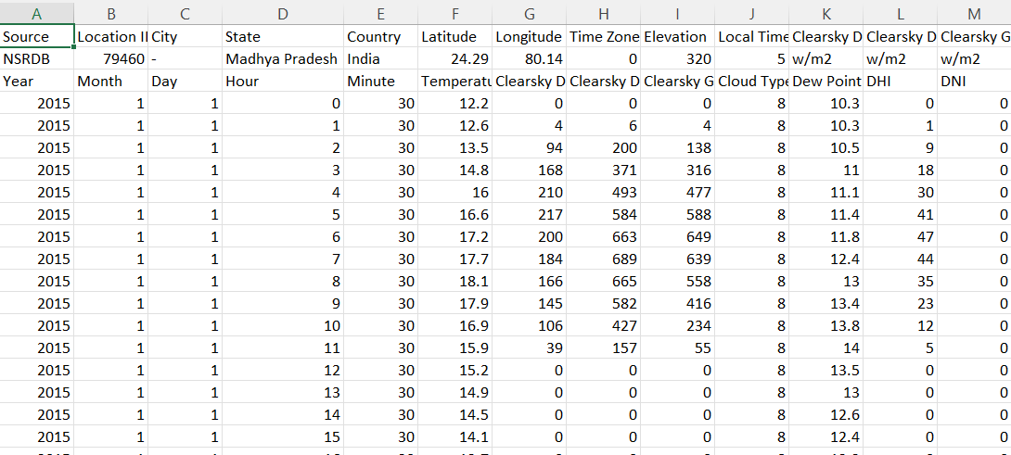
Snapshot of the Dataset

Slide 9
Challenges
The datasets mentioned in the paper are not available.
The Indian datasets do not contain data after year 2015.
The data is from year 2000 to 2015 only.
The code for the proposed model is not available on internet.
Mailing the author for further details on code and data did not yield any success.

Slide 10
Future Goals
Get the code of the proposed model.
Modify the code and make it work for our datasets.

Slide 11
References
Hybrid solar irradiance now-casting by fusing Kalman filter and regressor – ScienceDirect
NSRDB Data Viewer (nrel.gov)
Kalman filter - Wikipedia

Slide 12
Thank You

